Slide 1
Landscape Study Industry 4.0: Revolutionizing Manufacturing in India
~ BUREAU OF INDIAN STANDARDS

Slide 2
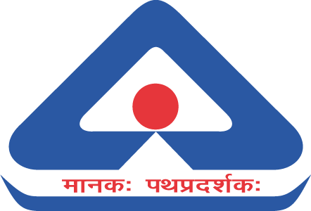
JOB DESCRIPTION
Presented by Nampally Sai Kiran Varma Soham Wanker B.tech Smart manufacturing PDPDM IIITDMJ Mentor : Ankita Srivastava

Slide 3
Acknowledgments
Completing the report "Industry 4.0 - Smart Manufacturing in India" has been a transformative journey filled with profound insights and growth. Our heartfelt gratitude extends to the Bureau of Indian Standards (BIS) for offering us this enlightening internship opportunity. We are profoundly thankful for the guidance and mentorship of Dr. Ankita Srivastava, Scientist-D, Department of LITD, BIS, whose unwavering support shaped our research direction. We sincerely appreciate the Indian Institute of Science (IISc) Bangalore and Schneider Electric for their cooperation during our enlightening visits. Special thanks to Prof. Amaresh Chakrabarti for the enlightening visit to the Industry 4.0 Research facility. Our gratitude also goes to Chidanand Burji for facilitating our insightful visit to Schneider Electric's innovative factory. Lastly, heartfelt appreciation to our families, friends, and colleagues for their steadfast support. This report is a testament to the collaborative efforts of many, contributing to the realization of this endeavor.
.

Slide 4

Purpose of this landscape study ?
This study facilitates a profound understanding of Industry 4.0's features, benefits, and implications, empowering Indian industries to make informed decisions in adopting cutting-edge technologies. It serves as a roadmap, showcasing how data-driven decision-making, human-machine collaboration, flexibility, and sustainability can drive enhanced productivity, efficiency, and competitiveness.
Furthermore, the study's insights into government initiatives, academia-industry collaborations, stakeholder engagement, and global smart manufacturing trends equip Indian industries to align with national strategies and international standards. By adopting Industry 4.0 practices, Indian industries can modernize their operations, strengthen their global standing, and contribute to economic growth while paving the way for a sustainable and technologically empowered future.

Slide 5

What is industry 4.0 ?
Industry 4.0, often referred to as the fourth industrial revolution, is a transformative paradigm that revolutionizes manufacturing by integrating advanced digital technologies into every aspect of the production process. It encompasses automation, data exchange, IoT (Internet of Things), cloud computing, and AI (Artificial Intelligence), enabling interconnected and intelligent systems to communicate, analyze, and make decisions in real-time.
Industry 4.0 aims to enhance operational efficiency, productivity, and innovation, ushering in an era of smart factories and supply chains. It emphasizes the fusion of physical and digital realms, enabling seamless information exchange, predictive analytics, and decentralized decision-making. This revolution has the potential to reshape industries, create new business models, and optimize resource utilization, ultimately fostering agile, data-driven, and sustainable manufacturing ecosystems.

Slide 6

Journey from I 1.0 to I 4.0
The industrial revolution began in the late 18th century with the invention of steam engines, which allowed for mass production and mechanization of factories. This was followed by the second industrial revolution in the late 19th century, characterized by the rise of electricity and assembly lines. The third industrial revolution, also known as the digital revolution, occurred in the late 20th century with the advent of computers and automation.
Industry 4.0 is the next step in this evolution of manufacturing, characterized by cyber-physical systems that integrate physical and digital technologies. It involves the use of sensors, big data analytics, and machine learning to optimize production processes and create smart factories. Industry 4.0 has the potential to transform the manufacturing industry in ways that were previously unimaginable.

Slide 7
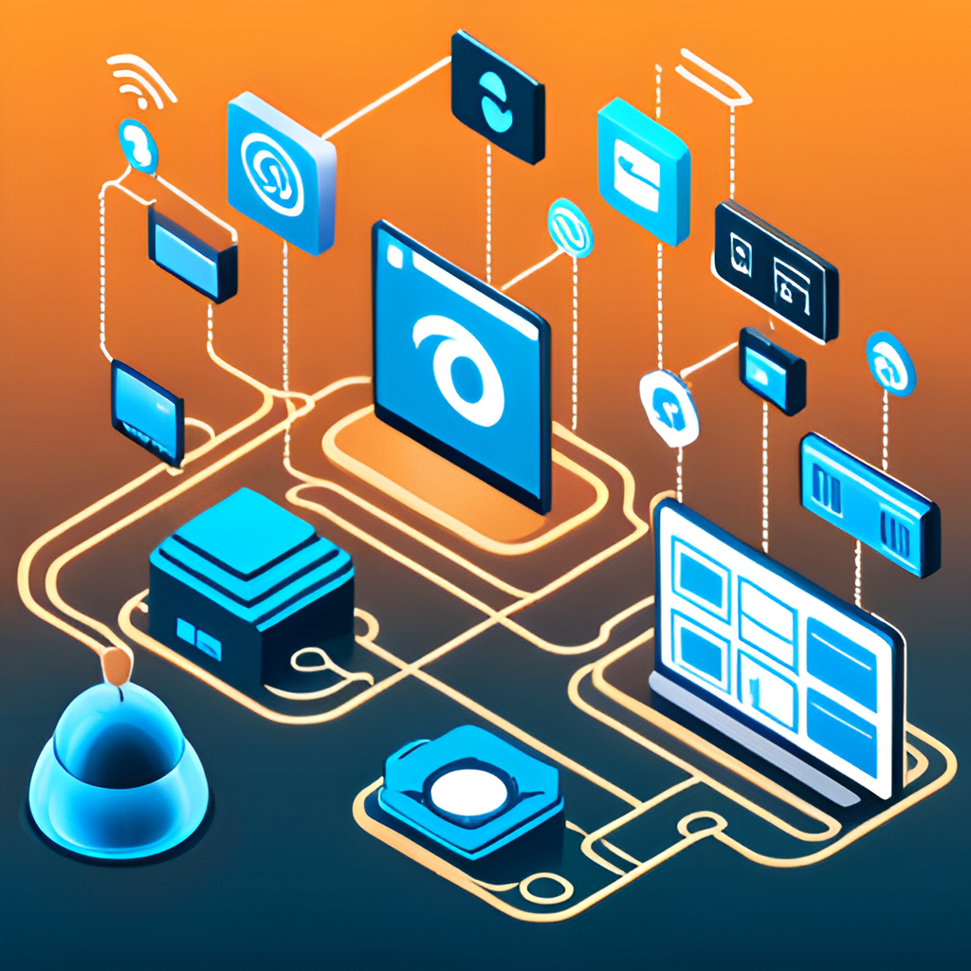
Key Features of Industry 4.0:
Automation
Digitization
Interoperability
Real-time Control
Sustainability
Data Autonomy
Resilience /Adaptability
Transparency
Predictability
Efficiency
Vertical Integration
Through-Engineering
Exponential Technologies

Slide 8
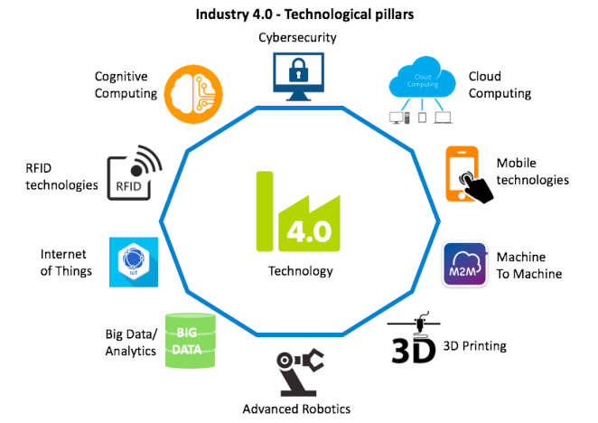
Key Technologies 4.0
Artificial Intelligence (AI) and Machine Learning (ML)
Robotics and Automation
Augmented Reality (AR) and Virtual Reality (VR)
Internet of Things (IoT) and Industrial IoT (IIoT)
Cybersecurity
Digital Twin
Data Visualization and Dashboards
Cyber-Physical Systems (CPS)
Additive Manufacturing (3D Printing)
Edge and Cloud Computing
Big Data Analytics
Autonomous Systems
Predictive Maintenance Technologies
Smart Materials
Human-Machine Interfaces (HMI)
.

Slide 9

Challenges and Risks of Industry 4.0
One of the major challenges associated with Industry 4.0 is cybersecurity threats. With the increasing use of connected devices and the internet of things (IoT), there is a greater risk of cyber attacks that can compromise sensitive data and disrupt operations. It is important for companies to implement robust security measures and stay up-to-date with the latest technologies to protect against these threats.
Another challenge is job displacement. As automation and artificial intelligence become more prevalent in the manufacturing sector, there is a concern that many jobs will become obsolete. However, it is important to note that Industry 4.0 also creates new job opportunities, particularly in areas such as data analytics and machine learning.

Slide 10
What is the Position of indian Industries
Technologies implemented :
1.Digital factories (going paper less)
2. Iot and high speed internert for data flow
3. Ai and ml
4. Software automation
Technologies need to be implemented (depends on requirement) :
1.Robots, cobots, AGVs 2. Digital twin (proress manufacturing)
3. Ar and Vr.
4. Predictive maintenance
5. Additive manufacturing

Slide 11
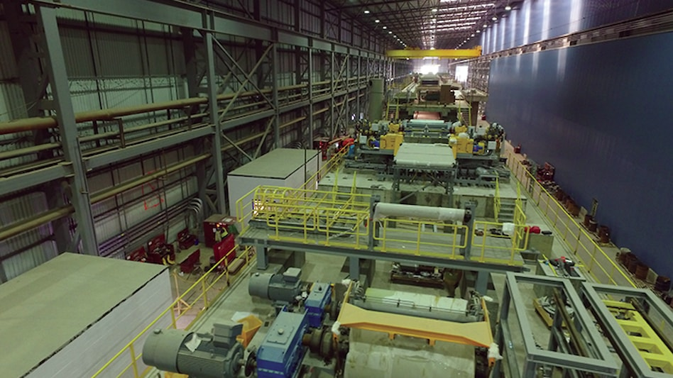
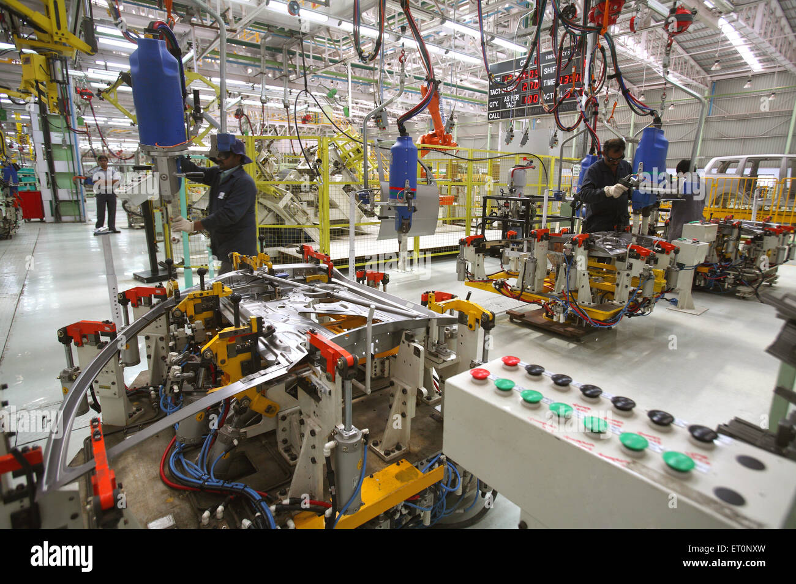

Case Studies
Successful Implementation of Industry 4.0 in India
One example of a successful implementation of Industry 4.0 in India is Tata Steel's Jamshedpur plant. By implementing advanced analytics and predictive maintenance, the plant was able to reduce downtime by 50% and increase production efficiency by 15%. This has resulted in significant cost savings for the company.
Another example is Mahindra & Mahindra's Nashik plant, which implemented a smart factory solution that enabled real-time monitoring of production processes and improved quality control. This led to a 20% reduction in defects and a 25% increase in productivity.
industry 4.0 laboratories: 1. IIT Delhi FSM Skills 2. IISc bengalore I4.0INDIA@IISC
.

Slide 12
Government Initiatives to Promote Industry 4.0 in India
1. SAMARTH - Udyog Bharat 4.0 is an initiative promoting Industry 4.0 awareness through demonstration centers.Indian.
a. Center for Industry 4.0 (C4i4) Lab Pune
b. IITD-AIA Foundation for Smart Manufacturing
c. I4.0 India at IISc Factory R&D Platform
d. Smart Manufacturing Demo & Development Cell at CMTI.
2. National Manufacturing Policy 2016:
This policy aims to make India a global manufacturing hub by 2025. It includes a number of initiatives to promote Industry 4.0, such as the development of smart factories and the promotion of automation.
3. Digital India:
This mission aims to make India a digitally empowered society and knowledge economy. It includes a number of initiatives to promote the use of ICT in manufacturing, such as the development of a national e-commerce platform and the promotion of e-manufacturing.
4. Pradesh Mantri Kaushal Vikas Yojana (PMKVY):
This scheme provides training to youth in Industry 4.0 skills. It has been implemented by the MSDE in collaboration with industry partners.
5. Production Linked Incentive (PLI) scheme:
This scheme provides financial incentives to companies that set up manufacturing units for high-tech products in India. It is expected to boost the production of these products in India and create jobs.

Slide 13
Government Initiatives to Promote Industry 4.0 in India
Government Ministries
Ministry of Electronics and Information Technology (MeitY): MeitY is responsible for developing and promoting the use of information and communication technology (ICT) in India. It has launched several initiatives to promote Industry 4.0, such as the National Manufacturing Policy 2016 and the Digital India initiative.
Ministry of Heavy Industry and Public Enterprises (MHI&PE): MHI&PE is responsible for the development of the heavy industry and public enterprises sector in India. It has launched the SAMARTH Udyog Bharat 4.0 initiative to promote the adoption of Industry 4.0 technologies by Indian manufacturers.
Ministry of Commerce and Industry (MoCI): MoCI is responsible for promoting trade and industry in India. It has launched the Make in India initiative to attract foreign investment and promote manufacturing in India.
Ministry of Skill Development and Entrepreneurship (MSDE): MSDE is responsible for developing skills and entrepreneurship in India. It has launched the Pradhan Mantri Kaushal Vikas Yojana (PMKVY) to provide training to youth in Industry 4.0 skills.
Ministry of Finance (MoF): MoF is responsible for the formulation and implementation of the government's fiscal policy. It has launched the Production Linked Incentive (PLI) scheme to promote the manufacturing of high-tech products in India.

Slide 14
.
Stakeholders
Front Runner Industries (Initiators - World):
A. Bosch
B. Siemens
C. SAP
D. ZF Friedrichshafen
E. Continental Existing Industries in India:
A. Automotive: Maruti Suzuki, Hero MotoCorp, Tata Motors, Mahindra & Mahindra
B. Manufacturing: TCS, Infosys, Wipro, HCL, Tech Mahindra
C. Retail: Reliance Retail, Future Retail, D-Mart, Flipkart, Amazon
D. Energy: ONGC, IOCL, BPCL, HPCL, NTPC
Possible Industries in India:
A. Agriculture.
B. Construction.
C. Logistics.
D. Transportation.
Front Runner Industries (Initiators - India):
A. Mahindra & Mahindra (Automotive, Agriculture)
B. Tata Motors (Automotive)
C. Larsen & Toubro (Manufacturing, Construction, Energy)
D. Jindal Steel & Power (Energy)
E. Reliance Industries (Energy, Retail)

Slide 15
.
Stakeholders
The stakeholders Should involve in establishing Industry 4.0 standards in India
1 Government Institutions:
A.Bureau of Indian Standards (BIS)
B.Ministry of Electronics and Information Technology (MeitY)
C.Ministry of Commerce and Industry
2 Industry Associations :
A.Confederation of Indian Industry (CII)
B.Federation of Indian Chambers of Commerce and Industry (FICCI)
C.NASSCOM (National Association of Software and Service Companies)
3 Research and Development Institutes:
A. Indian Institutes of Technology (IITs)
B.Indian Institute of Information Technology (IIITs)
C. National Institutes of Technology (NITs)
D. Research institutions associated with universities (IISC)
E.Council of Scientific and Industrial Research (CSIR)
4 Technology Providers and Solution Providers:
A. Tata Consultancy Services (TCS)
B. Wipro
C. Infosys
D. Tech Mahindra
5 Industrial Experts and Consultants:
A.Bosch
B.Schneider Electric
C.Ola Future Factory
6 Manufacturing Companies:
A.Larsen & Toubro (L&T)
B.Mahindra & Mahindra
C.Hindalco Industries
D.Maruti Suzuki
E.Godrej Consumer Products
7 Industry-specific Associations:
A.Society of Indian Automobile Manufacturers (SIAM)
B.Indian Pharmaceutical Association (IPA)
C.National Association of Software and Service Companies (NASSCOM)
.

Slide 16
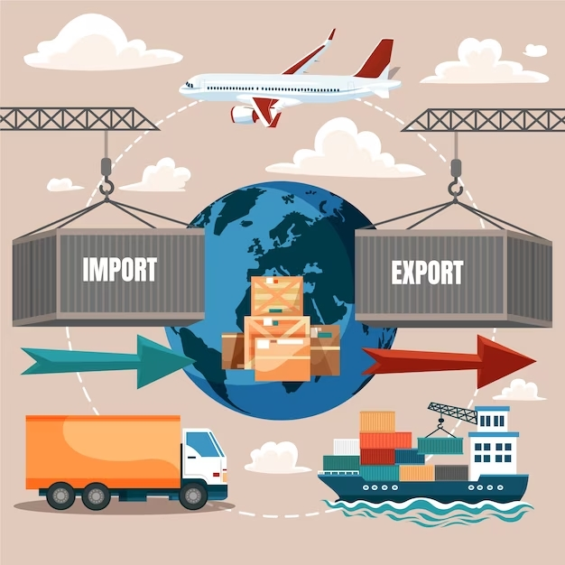
Import Potential of Industry 4.0 in India
"Make in India" Initiative:
Aims to promote import substitution, exports, and employment across sectors.
Focus on 27 sub-sectors, including electronics, steel, textiles, and EV components.
Key Technologies Imported (2022-2023):
Semiconductors: $4.5 billion (2023)
Machinery: $3.5 billion (2023)
Electronics: $2.5 billion (2023)
Software: $1.5 billion (2023)
Export Potential:
Early adopters have a competitive edge in the global market.
Exporting Industry 4.0 technologies boosts economic growth.
Key Exportable Technologies Include:
Robotics, Sensors, Software, Connectivity, AI, IoT, Cloud Computing, Additive Manufacturing, Big Data Analytics.
Pros of Export Potential:
Competitive advantage, scalability, improved supply chain visibility, cost reduction.

Slide 17

Industry 4.0 Technologies and Sustainability
1. Real-time Monitoring and Data Analytics
2. Predictive Maintenance
3. Energy Management
4. Digital Twins for faster defects detection
5. Resource Optimization (inventory)
6. Supply Chain Transparency (raw material management)
7. Smart Logistics (optimised transportation)
8. Customization and Local Production
9. Reduction in carbon foot print
10. Collaborative and Decentralized Production
11. Reduced Paper Consumption
12. Employee Well-being

Slide 18
N. Sai kiran Varma & Soham Wanker
Thank you….

